Slide 1
Universitäres Institut akkreditiert nach HFKG
Institut universitaire accrédité selon la LEHE
Diagnosing 3S
Notes:
Recent paper
Not discuss everything. Mostly important for the question raised and idea of future directions and projects.

Slide 2
Methods

Slide 3
Line crossings
2
5
Rationale: Synesthetic forms should have few crossings.
4
1
3
i.e. 3 crossings:
1-2 & 3-4
1-2 & 4-5
2-3 & 4-5

Slide 4
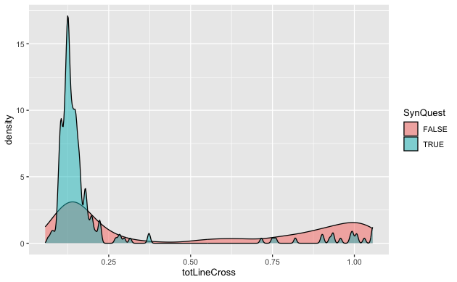
“Line crossing” criteria

Slide 5
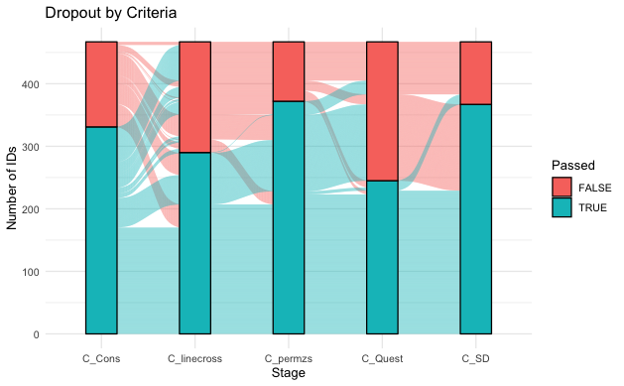
Comparing criteria
Only Ward Data

Slide 6
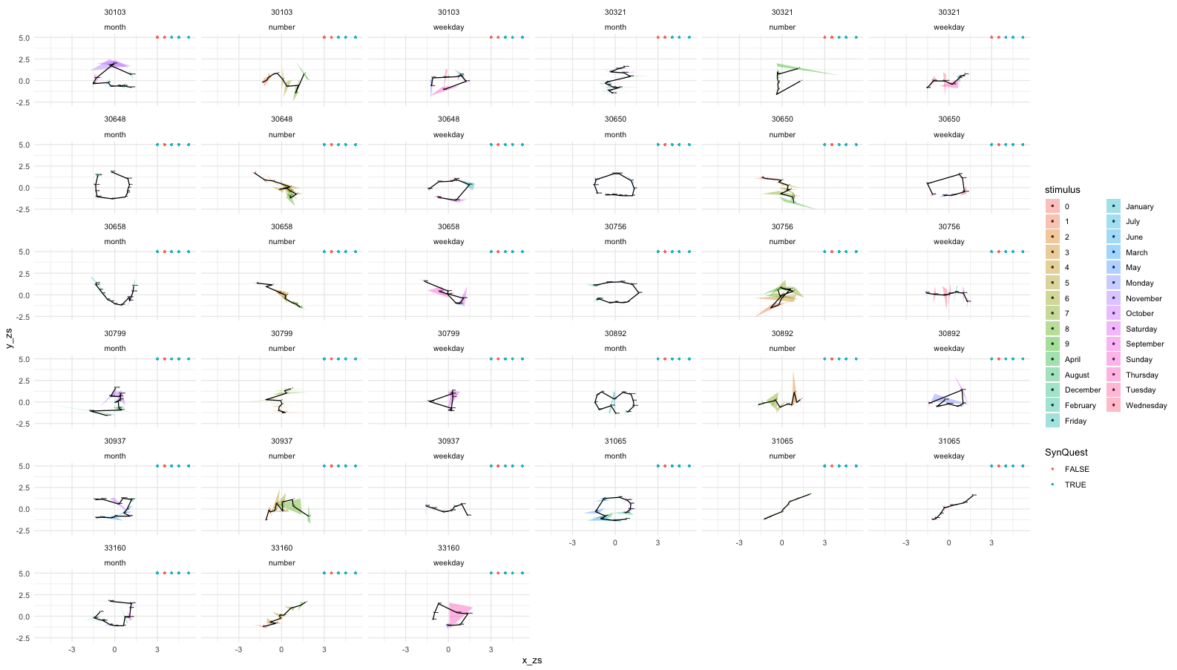
Inconsistent but pass Line

Slide 7
Question
How to compare criteria?
Add other data?
How to set cutoffs?

Slide 8
Vielen Dank für Ihre Aufmerksamkeit! Merci pour votre attention ! Thank you for your attention!
Universitäres Institut akkreditiert nach HFKG
Institut universitaire accrédité selon la LEHE

